Slide 1

Unit 3.3:
Join dataframes, group by, correlations of variables
Utrecht Summer School:
Programming with Python 2023
All icons by: https://www.flaticon.com/

Slide 2

Previous lecture
File I/O
Basic Pandas
Remote resources (server - WWW)
the basics of resources on the web,
how to access remote resources (files, REST services),
XML files
how to scrape content form the HTML representation of websites
→ web scrapping

Slide 3
This lecture
More Pandas!
Python libraries for data science applications
Pandas
Numpy
Matplotlib

Slide 4
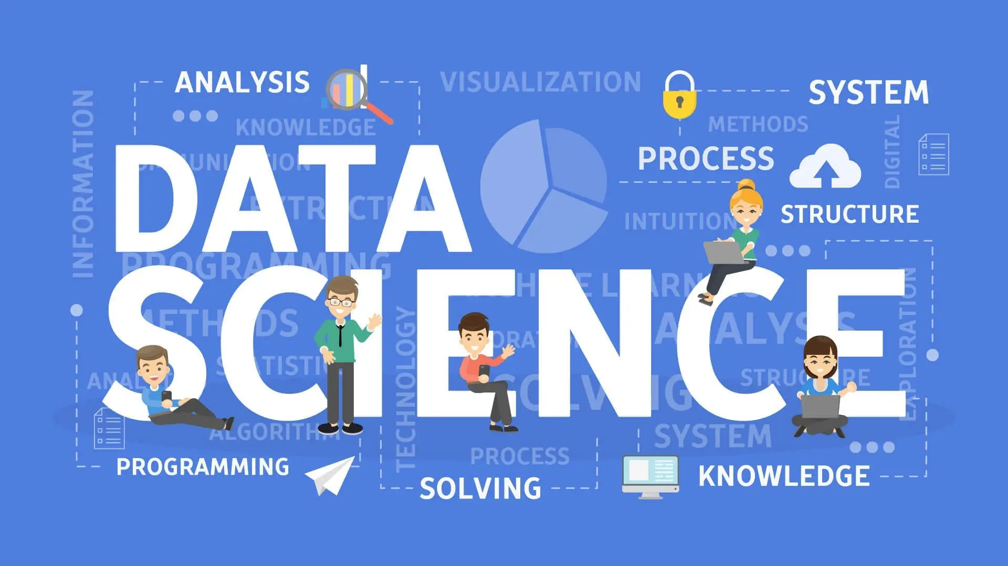
https://www.dataquest.io/blog/what-is-data-science/

Slide 5
What is data science?
Sources: https://towardsdatascience.com/what-is-data-science-8c8fbaef1d37, https://towardsdatascience.com/the-data-scientists-toolbox-part-1-c214adcc859f,https://ourworldindata.org/grapher/daily-covid-deaths-per-million-7-day-average?time=2020-07-07..&country=CAN~DEU~ITA~JPN~KOR~GBR~USA~ESP

Slide 6
What is data science?
Answers can be confusing …
  statistics dressed up in fancy clothes
  statistics on a Mac
  a data scientist has been called a data analyst who lives in California
In broad terms, Data Science is about using data to answer questions
Sources: https://towardsdatascience.com/what-is-data-science-8c8fbaef1d37, https://towardsdatascience.com/the-data-scientists-toolbox-part-1-c214adcc859f,https://ourworldindata.org/grapher/daily-covid-deaths-per-million-7-day-average?time=2020-07-07..&country=CAN~DEU~ITA~JPN~KOR~GBR~USA~ESP

Slide 7
What is data science?
Answers can be confusing …
  statistics dressed up in fancy clothes
  statistics on a Mac
  a data scientist has been called a data analyst who lives in California
In broad terms, Data Science is about using data to answer questions
Sources: https://towardsdatascience.com/what-is-data-science-8c8fbaef1d37, https://towardsdatascience.com/the-data-scientists-toolbox-part-1-c214adcc859f,https://ourworldindata.org/grapher/daily-covid-deaths-per-million-7-day-average?time=2020-07-07..&country=CAN~DEU~ITA~JPN~KOR~GBR~USA~ESP

Slide 8
What is data science?
Answers can be confusing …
  statistics dressed up in fancy clothes
  statistics on a Mac
  a data scientist has been called a data analyst who lives in California
In broad terms, Data Science is about using data to answer questions
Sources: https://towardsdatascience.com/what-is-data-science-8c8fbaef1d37, https://towardsdatascience.com/the-data-scientists-toolbox-part-1-c214adcc859f,https://ourworldindata.org/grapher/daily-covid-deaths-per-million-7-day-average?time=2020-07-07..&country=CAN~DEU~ITA~JPN~KOR~GBR~USA~ESP

Slide 9
What is data science?
Answers can be confusing …
  statistics dressed up in fancy clothes
  statistics on a Mac
  a data scientist has been called a data analyst who lives in California
In broad terms, Data Science is about using data to answer questions
Sources: https://towardsdatascience.com/what-is-data-science-8c8fbaef1d37, https://towardsdatascience.com/the-data-scientists-toolbox-part-1-c214adcc859f,https://ourworldindata.org/grapher/daily-covid-deaths-per-million-7-day-average?time=2020-07-07..&country=CAN~DEU~ITA~JPN~KOR~GBR~USA~ESP

Slide 10
What is data science?
Answers can be confusing …
  statistics dressed up in fancy clothes
  statistics on a Mac
  a data scientist has been called a data analyst who lives in California
In broad terms, Data Science is about using data to answer questions
Sources: https://towardsdatascience.com/what-is-data-science-8c8fbaef1d37, https://towardsdatascience.com/the-data-scientists-toolbox-part-1-c214adcc859f,https://ourworldindata.org/grapher/daily-covid-deaths-per-million-7-day-average?time=2020-07-07..&country=CAN~DEU~ITA~JPN~KOR~GBR~USA~ESP

Slide 11
What is data science?
Specifically, a data science project has one of three goals — either to provide insight, establish causality, or make predictions
These three goals are associated with the domains of data analysis, statistics, and machine learning.
Sources: https://towardsdatascience.com/what-is-data-science-8c8fbaef1d37, https://towardsdatascience.com/the-data-scientists-toolbox-part-1-c214adcc859f,https://ourworldindata.org/grapher/daily-covid-deaths-per-million-7-day-average?time=2020-07-07..&country=CAN~DEU~ITA~JPN~KOR~GBR~USA~ESP

Slide 12
What is data science?
Specifically, a data science project has one of three goals — either to provide insight, establish causality, or make predictions
These three goals are associated with the domains of data analysis, statistics, and machine learning.
Sources: https://towardsdatascience.com/what-is-data-science-8c8fbaef1d37, https://towardsdatascience.com/the-data-scientists-toolbox-part-1-c214adcc859f,https://ourworldindata.org/grapher/daily-covid-deaths-per-million-7-day-average?time=2020-07-07..&country=CAN~DEU~ITA~JPN~KOR~GBR~USA~ESP

Slide 13
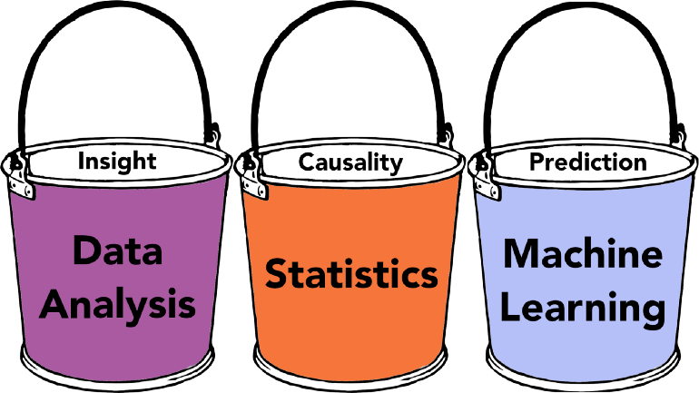
What is data science?
Specifically, a data science project has one of three goals — either to provide insight, establish causality, or make predictions.
These three goals are associated with the domains of data analysis, statistics, and machine learning.
Sources: https://towardsdatascience.com/what-is-data-science-8c8fbaef1d37, https://towardsdatascience.com/the-data-scientists-toolbox-part-1-c214adcc859f,https://ourworldindata.org/grapher/daily-covid-deaths-per-million-7-day-average?time=2020-07-07..&country=CAN~DEU~ITA~JPN~KOR~GBR~USA~ESP

Slide 14


